Slide 1

GROCERY RECOMMENDATION SYSTEM FOR RETAIL MARKETS

Slide 2

All online retail apps have proved that, when a retailer knows its customers, it can serve them more effectively. But how does that work in a physical, offline grocery retail environment? One way is to integrate a facial recognition system. Face recognition technology enables offline grocery stores to do what the online shopping recommendation systems have been doing for year’s i.e., cameras in offline grocery shops identifies their shoppers/customers, link them to past purchases and generate personalized product recommendations based on the data.

Slide 3
Using a combination of in-store cameras and facial recognition software, shops can now easily asses the purchase data of the customers and recommend products based on the history. This core data can be collected at each stage of the customer journey, tracking shoppers (and how they interact with a store) from entry to checkout. Not only can face recognition technology identify and classify customers, it can help retailers optimize and plan their product offerings.

Slide 4
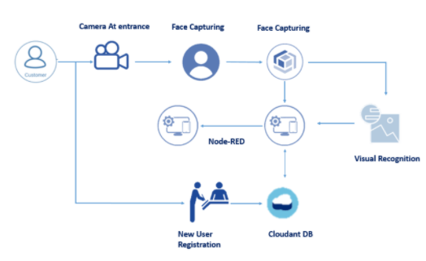

Slide 5
How it works???
Customer Enters the store and store cameras identifies the face of the customer.
The identified face is stored in the cloud object storage service and the respective image URL is stored in Cloudant DB
Fetch the stored image.
This image is then sent to the custom model build for face recognition using Visual recognition
If the customer is new then he gets registered at the entrance.

Slide 6
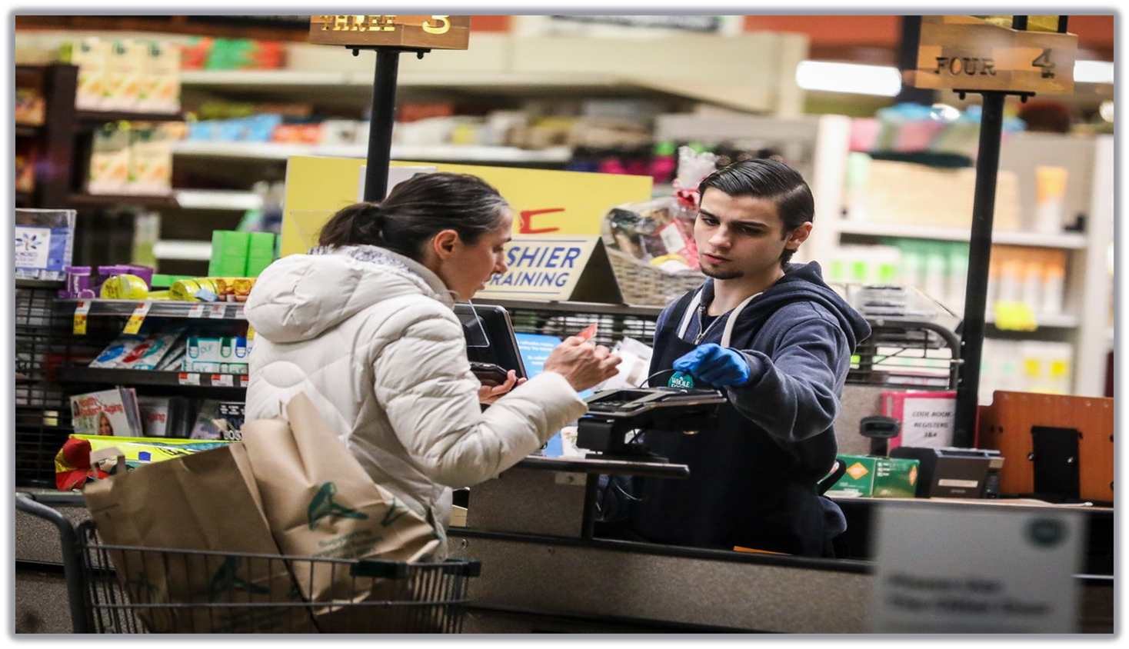
Once the customer is recognized we retrieve the previous products purchased by the customers from cloudant DB.
Based on previous purchases recommendations are showcased on the UI displayed at the entrance for a particular customer.
If the customer is new then he gets registered at the entrance.

Slide 7

To accomplish this, we have to complete all the activities and tasks listed below
Create IBM service Create Convolution Neural Network
Create Cloud object Storage Service
Create Node-red Service
Create Cloudant Db service

Slide 8
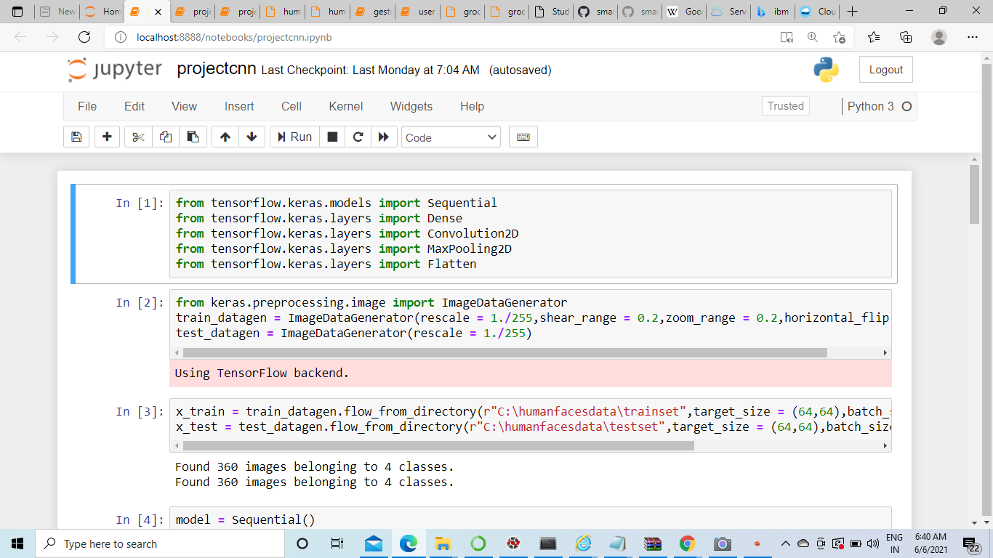
CNN TRAINING

Slide 9
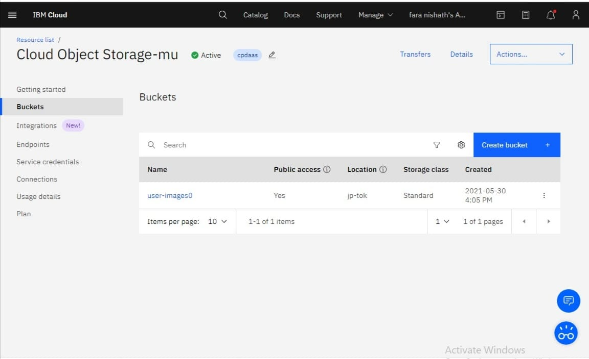
Creating Bucket and Database
Let's create Cloud object Storage Bucket
upon login to IBM Cloud, you will be redirected to IBM Dashboard
From the dashboard Click on Storage
once you login to IBM click on Storage, open Cloud object storage service
Select Buckets and click on Create Bucket
A pop up display select Custom Bucket
Configure the bucket details as shown in the below
Bucket name : user images
Resiliency : Regional
Location : jp-tok
Storage Class : standard
Your Bucket is created

Slide 10

Open CV Analysis
Import The Libraries
Initialise Cloud Object Storage And Cloudant Credentials
Define A Function To Store Image In Cloud Object Storage
Save The Detected Face
Test The Output

Slide 11
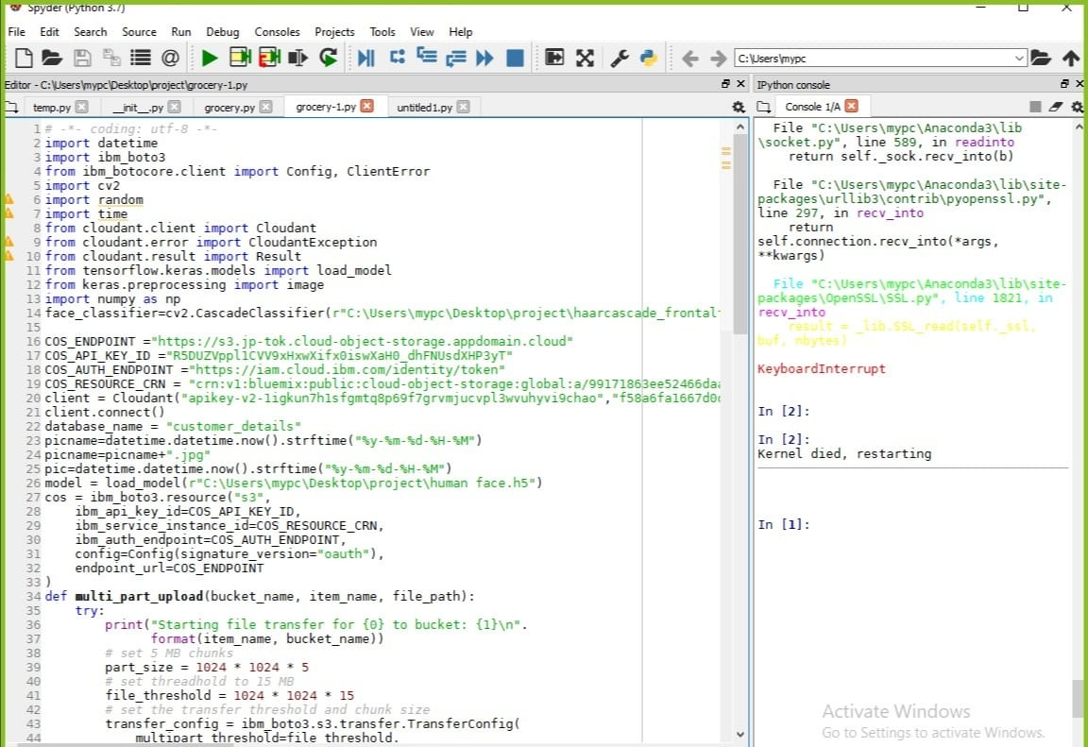
Open cv analysis.

Slide 12
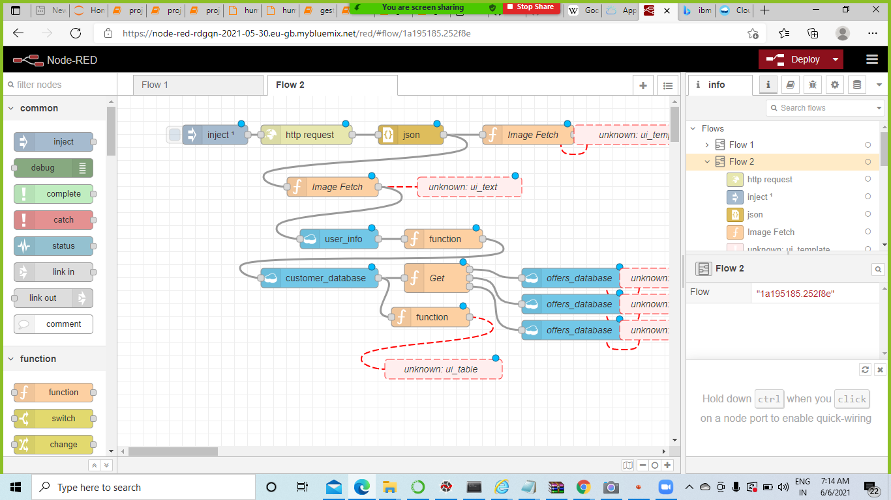
Build Node-RED Application

Slide 13
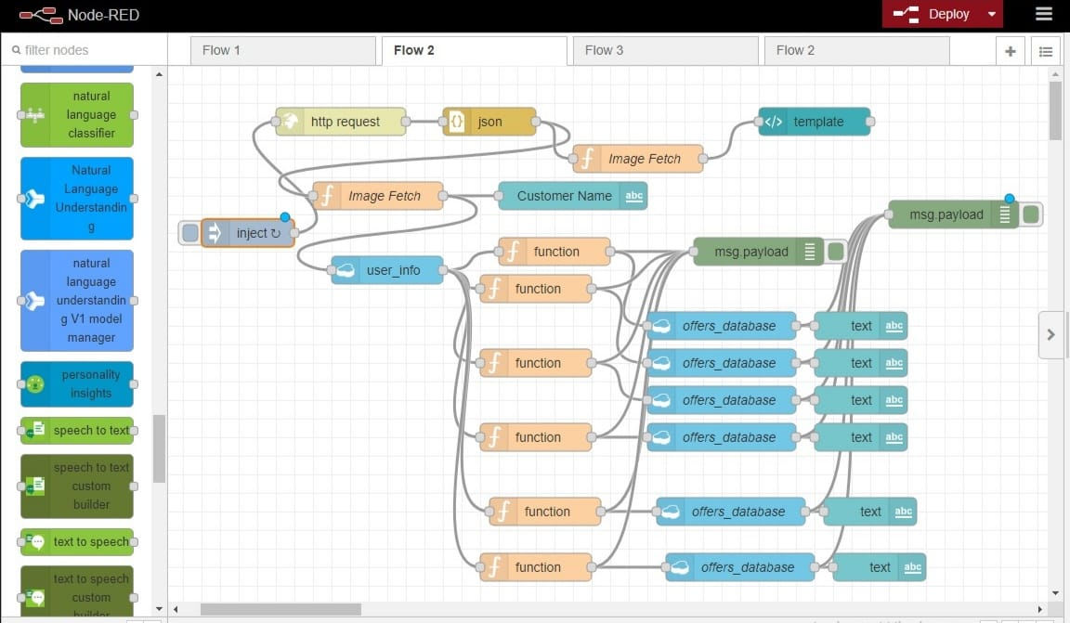

Slide 14
Result:
Lets see the result after deploying the node red and running the code.

Slide 15
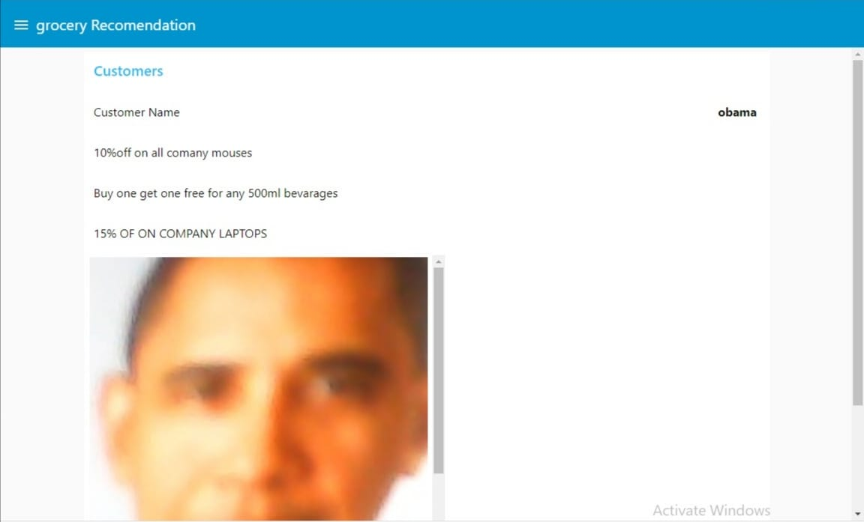
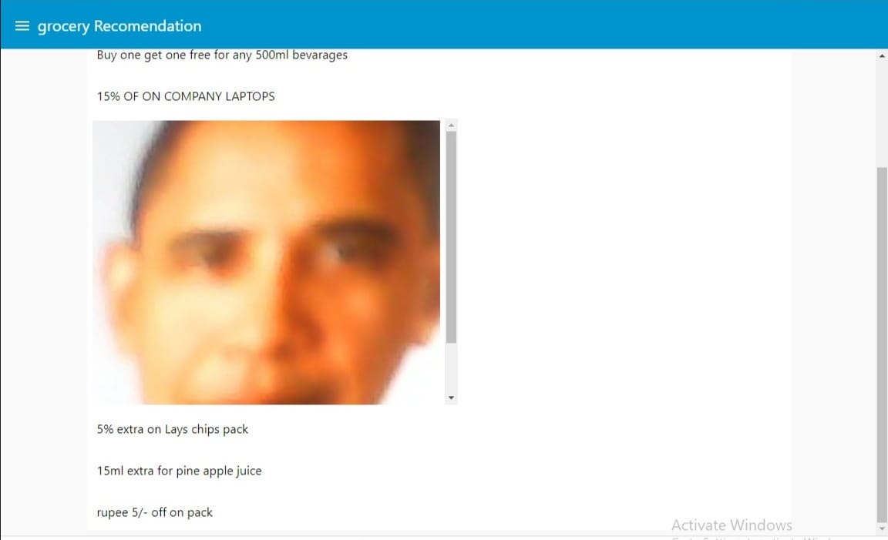

Slide 16
Conclusion:
This Guided Project focuses on building a system where cameras at entry recognize the customer and link his previous purchase history stored in the database. Based on that purchase history he will get a recommendation of the offers on the product which he wishes to buy. And also displays on the screen at the entrance as soon as he steps into the store .

Slide 17
THANK YOU.!
TEAM:
FARANISHATH
G.VAISHNAVI
CH.BHAVANI
CH.SRAVYA SRI
D.KARTHIK REDDY

